Slide 1
Unsupervised Exploration of Temperatures
Scanning L-Band Active Passive (SLAP)

Slide 2
Data Information
This dataset comes from the NASA program SLAP(Scanning L-Band Active Passive). Their main goal is to measure soil moisture using temperature readings. These readings are taken using a device that is attached to a plane which flies in a rectangular pattern to capture a pre-determined plot of earth. The device used to take readings utilizes an oscillating sensor that takes readings in an elliptical pattern.
There is a need for this group to accurately determine which areas are land and which are water. This is mainly found through temperature readings, and the algorithms they use are inaccurate due to the fact they are mainly using google earth and guessing by eye.
For this project, I will be using KMeans to assign new flags for water. My goal is to identify at least 3 values (water, shoreline, and dry land).
Key Term:
Brightness Temperature: a measure of the intensity of radiation
SLAP: remote sensing instrument developed at NASA Goddard Space Flight Center for remote sensing of soil moisture, ocean salinity, freeze-thaw state, and other physical phenomena that display characteristics at microwave L-band

Slide 3
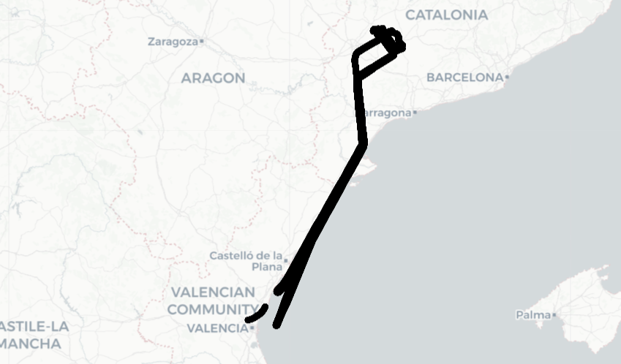

Slide 4
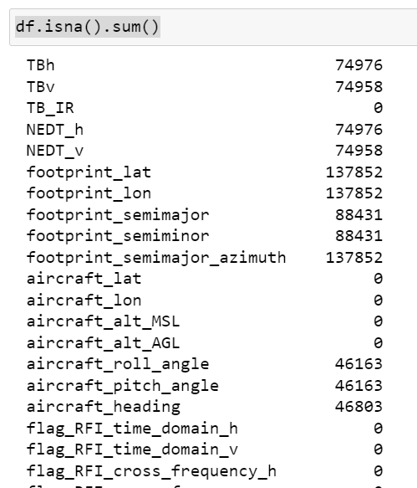
Data Cleaning
Removed NA rows; The first part of the dataset is calibration data that takes place on the ground. This is shown in the number of NA values in footprint_lat/footprint_lon.
Removed any miscellaneous spaces in the column names
Start shape: (320855, 38)
End shape:
(182419, 38)

Slide 5
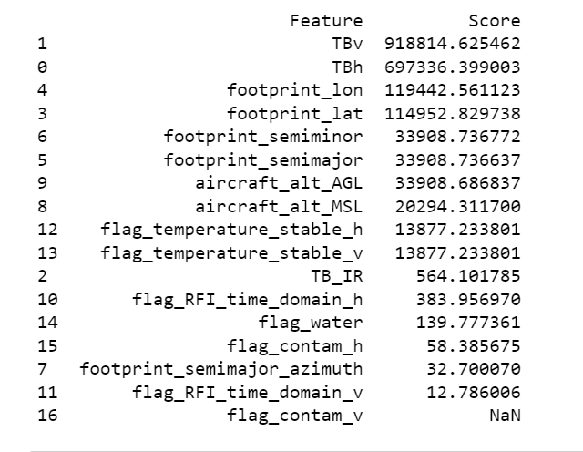
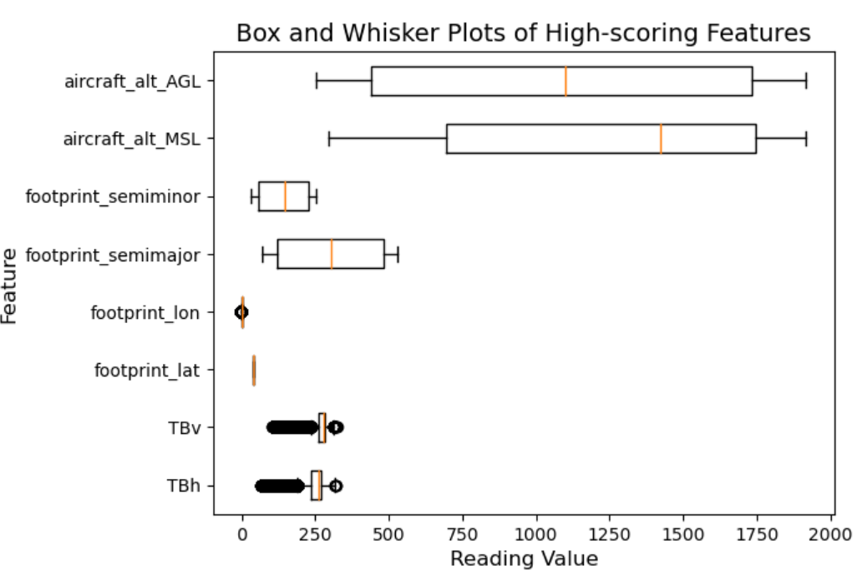
SelectKBest using supplied water flag

Slide 6
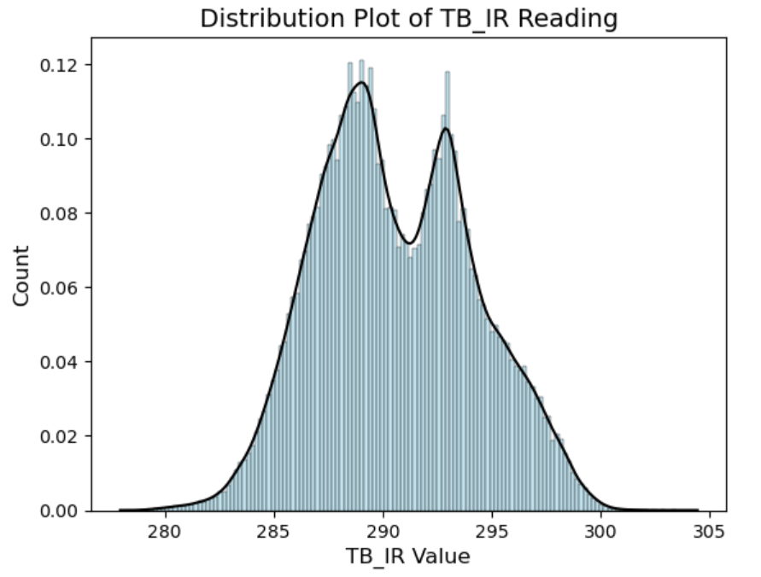
Distribution Plots of Infrared Brightness Temperature (TB_IR)

Slide 7
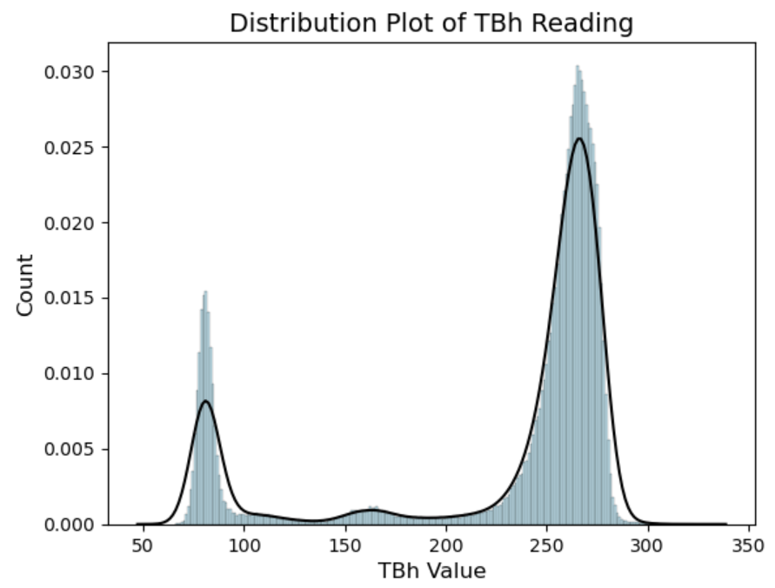
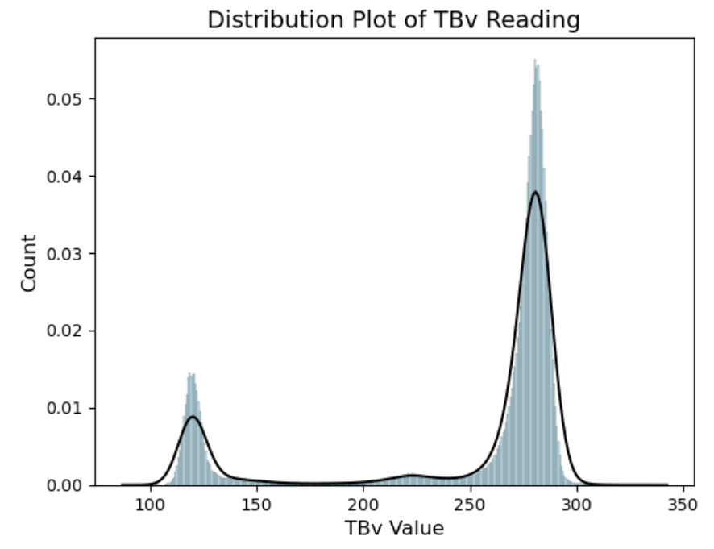
Distribution Plots of H-pol Brightness Temperature (TBh) and V-pol Brightness Temperature (TBv)

Slide 8
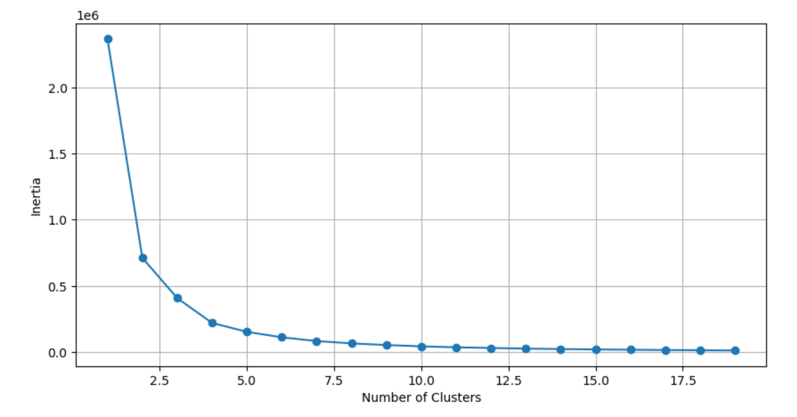
Temperature Brightness Infrared (TB_IR) in Kelvin
Most accurate “real” temperature. Similar to the infrared temperature gauges used to take body temperature.

Slide 9
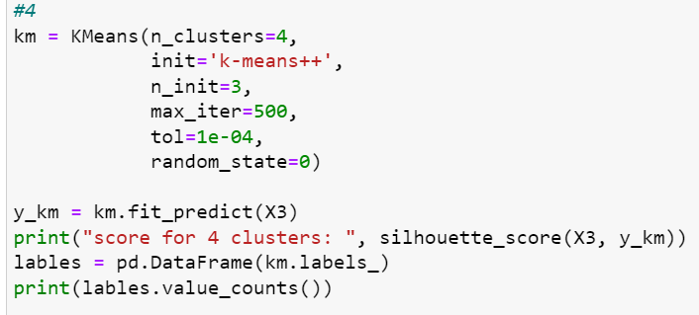
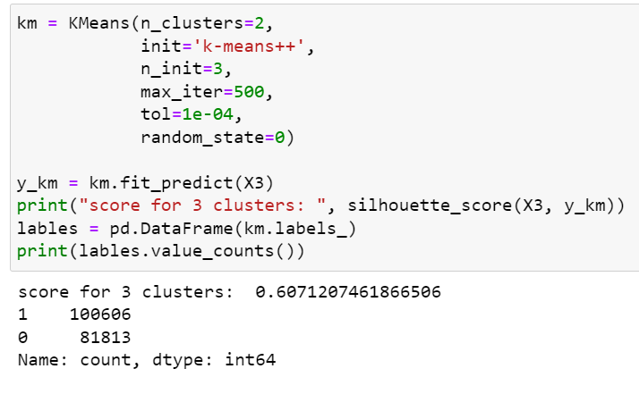
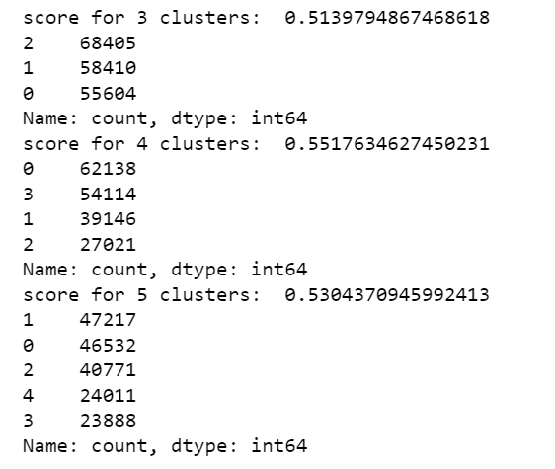
Temperature Brightness Infrared (TB_IR) in Kelvin
2

Slide 10
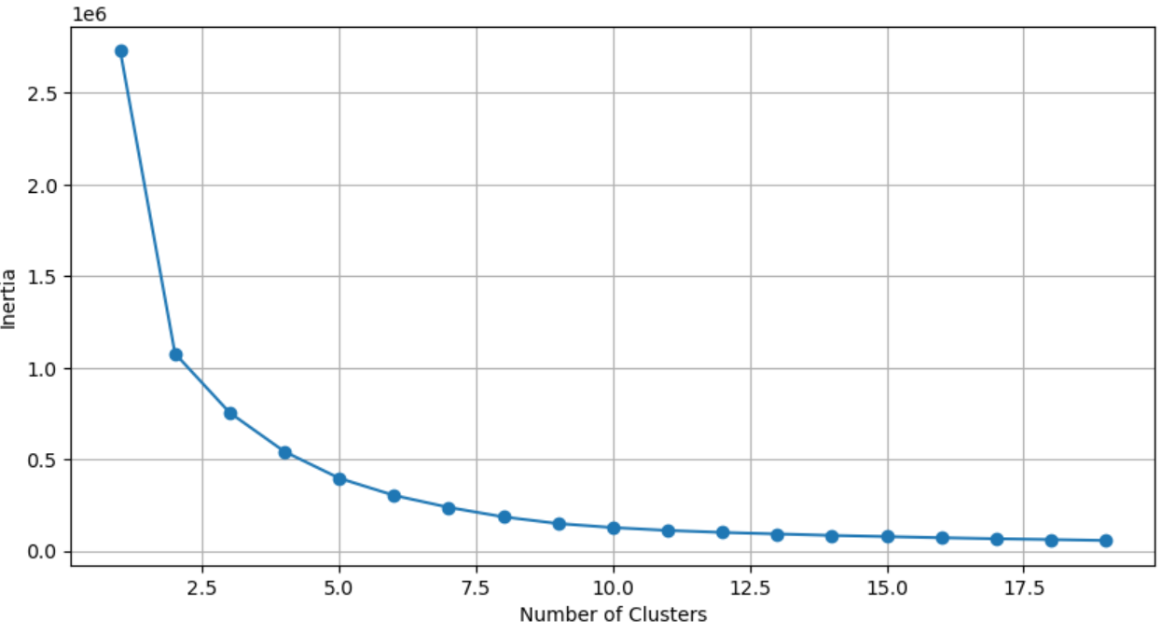
TB_IR included with TBh and TBv

Slide 11
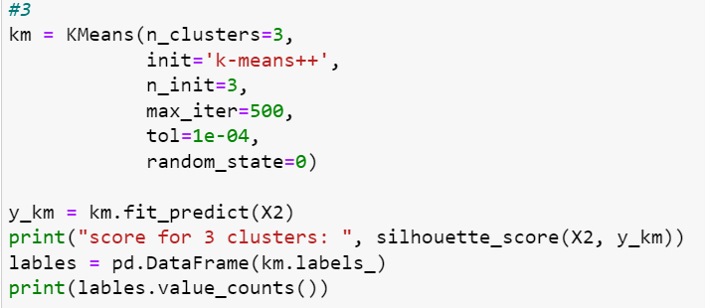
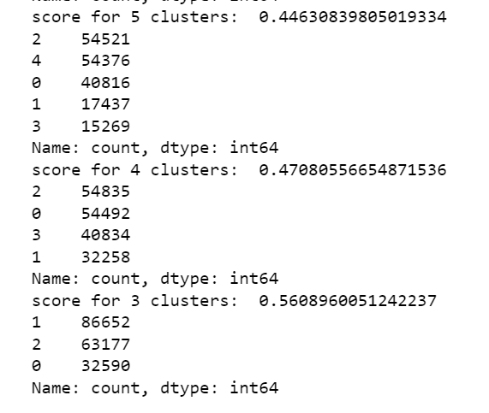
TB_IR included with TBh and TBv

Slide 12
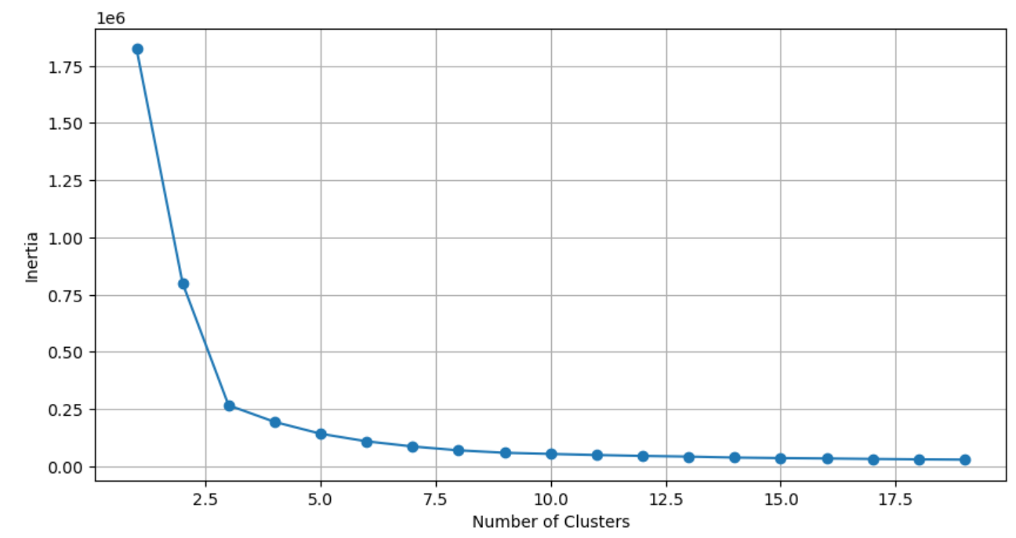
All High-Scoring

Slide 13
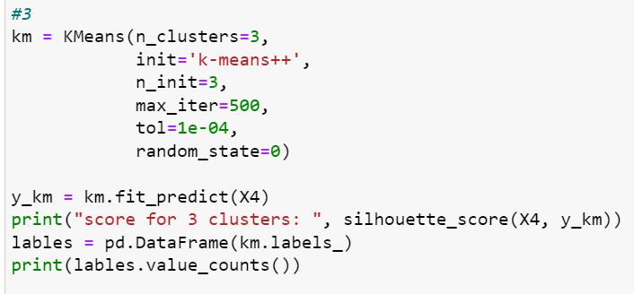
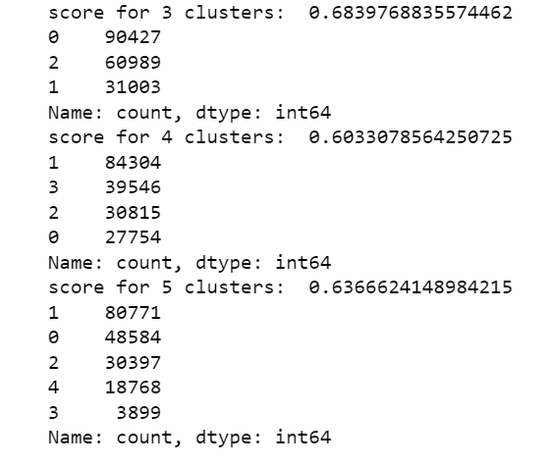
All High-Scoring

Slide 14
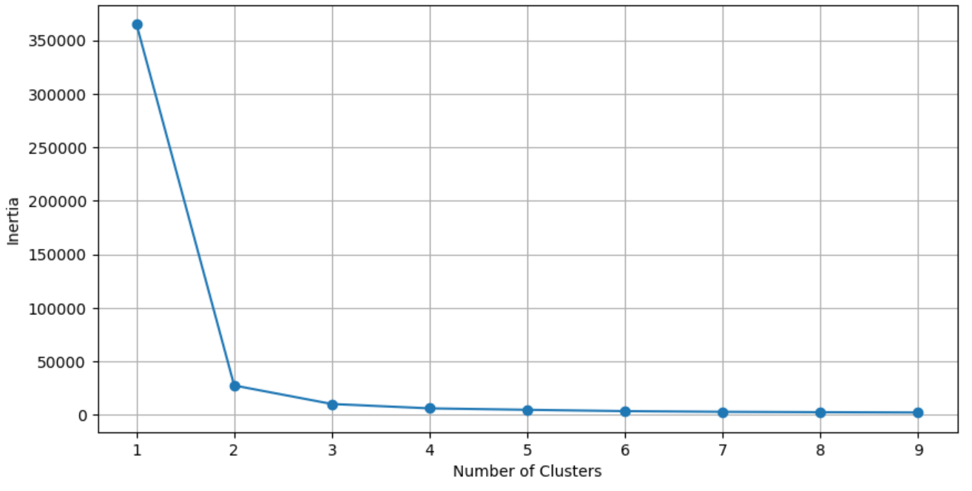
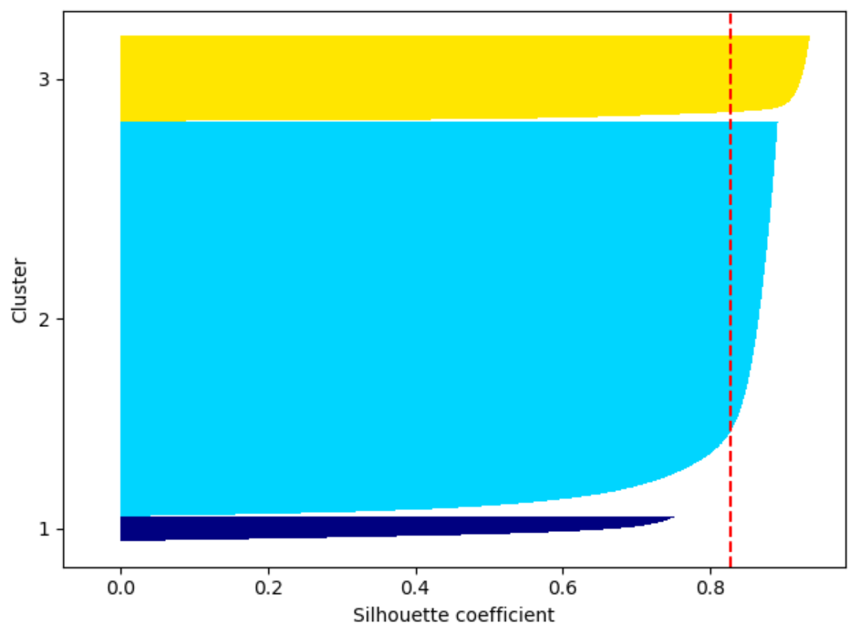
TBh and TBv

Slide 15
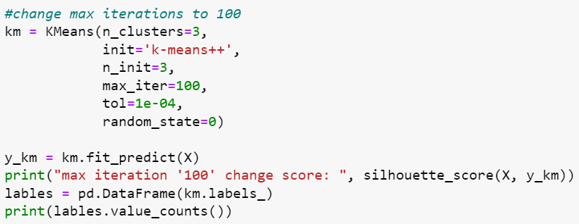
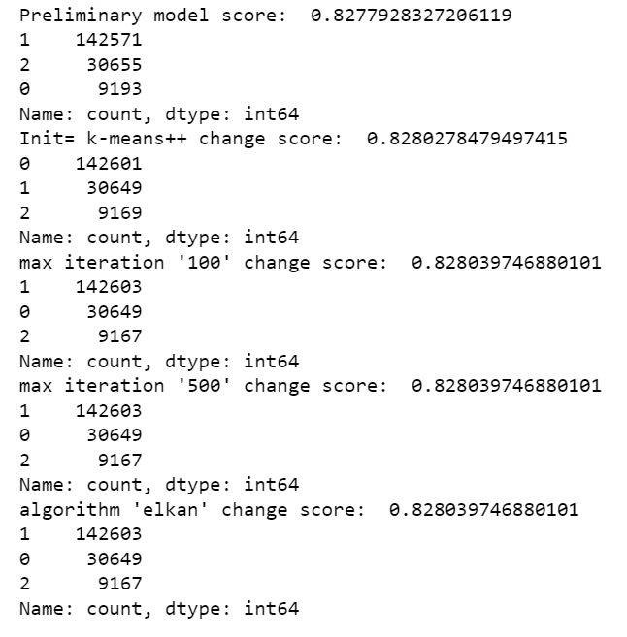
Best Model (TBh and TBv)

Slide 16
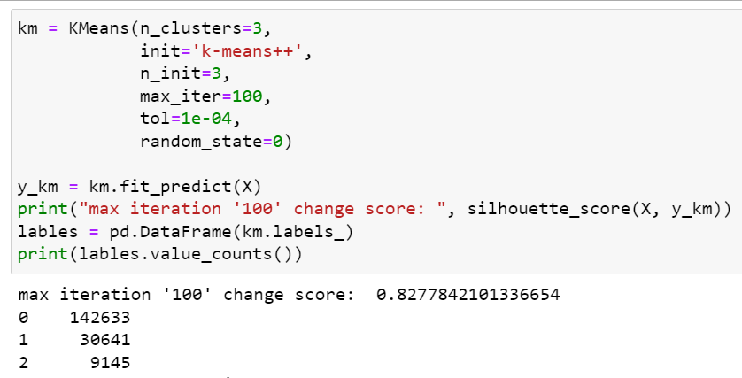
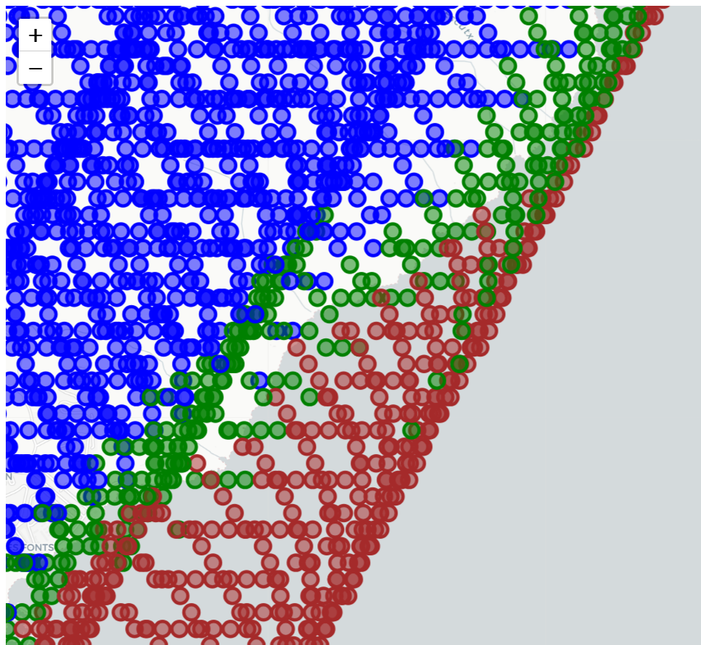
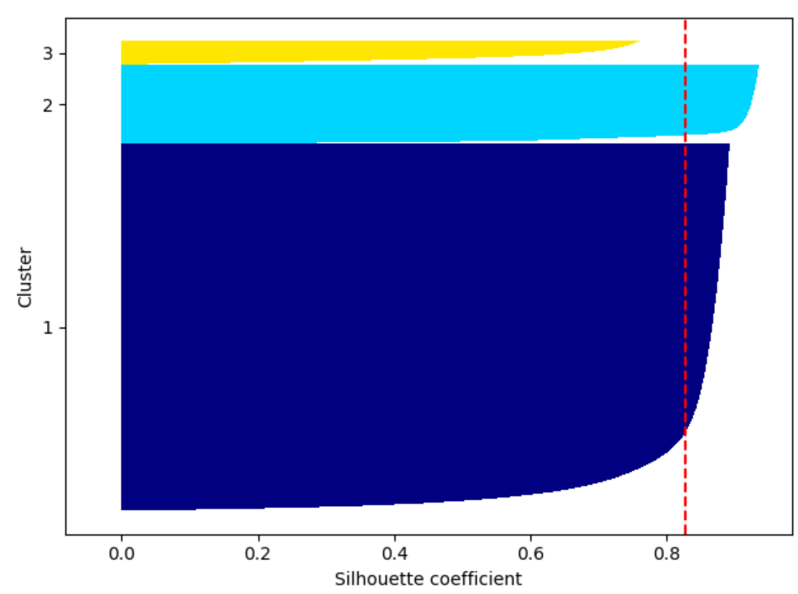
Best Model Map

Slide 17
